Slide 1







Ecohydrological modeling for boreal forestry
Samuli Launiainen, Kersti Leppä, Leena Stenberg, Aura Salmivaara, Jari-Pekka Nousu, Olli-Pekka Tikkasalo, Toprak Aslan, Hannu Hökkä, Mika Nieminen and Annamari Laurén

Slide 2
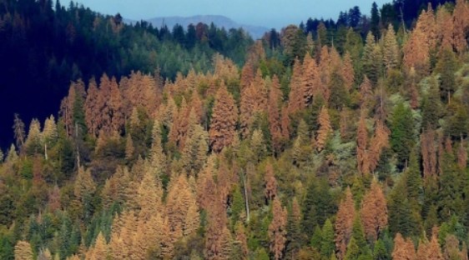
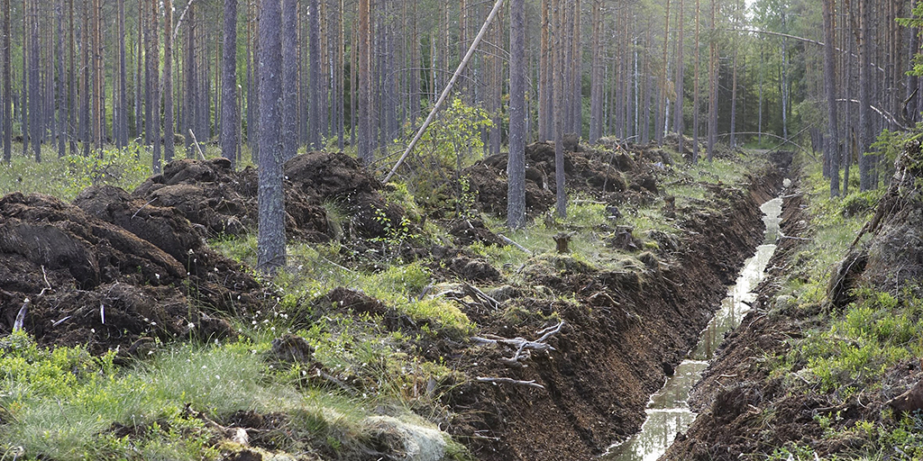
Water – the necessary evil
drought
excess
Biological activity
0
1
water content / porosity
Of interest when a problem

Slide 3
climate
Process-based ecosystem models
Land-surface models
Water availability or excess
soil texture
topography
fertility
?
Vol.
LAI
site characteristics
stand attributes
BA
hydrologic regime
dbh
species
feedbacks
impacts
ditch maintenance
ditch blocking
site preparation
fertilization
forest renewal (EAF, CCF)
thinnings
species selection
Management

Slide 4
Process-based ecohydrological models
climate
Water availability or excess
?
site characteristics
stand attributes
Management

Slide 5
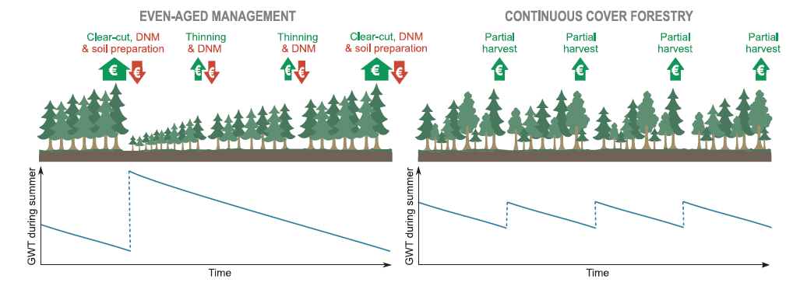
Peatland management ≈ water table management
4,7 Mha ditched from 1930’s to 1980’s. Spacing 20 – 60m, current depth 20 – 80cm
How WTL depends on stand attributes and peatland type across a climate gradient?
Growth = f(WTL)
GHG emissions = f(WTL)
Improved drainage by ditch maintenance: When needed & how deep is necessary?
Biological drainage == stand water use
How intense selection harvests or strip-cuttings
can be used?
Nieminen et al. 2018; https://doi.org/10.1016/j.foreco.2018.04.046

Slide 6
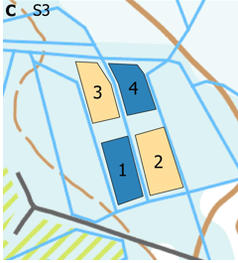

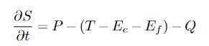
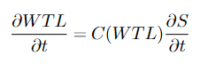
Modeling water table response
Ecohydrological theory & literature
Process-model structure, functions, parameters
Inputs (open data):
Forest attributes: LAI, height, tree type
Peat type: hydraulic properties
Ditch spacing & depth
Daily weather data
Outputs (daily):
WTL, soil moisture, snow, ET & components, runoff
KISS for practical use
Precipitation (P)
Transpiration (T)
Interception (E_{c})
tree canopy
Evaporation (E_{f})
throughfall
moss
snow
infiltration
Drainage (Q)
L
Peat water storage (S)
L

Slide 7
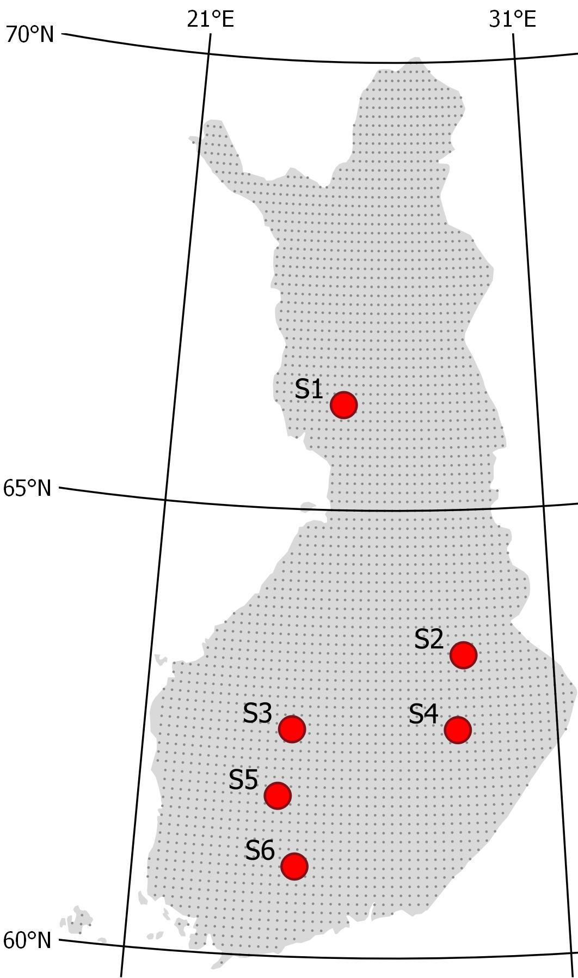
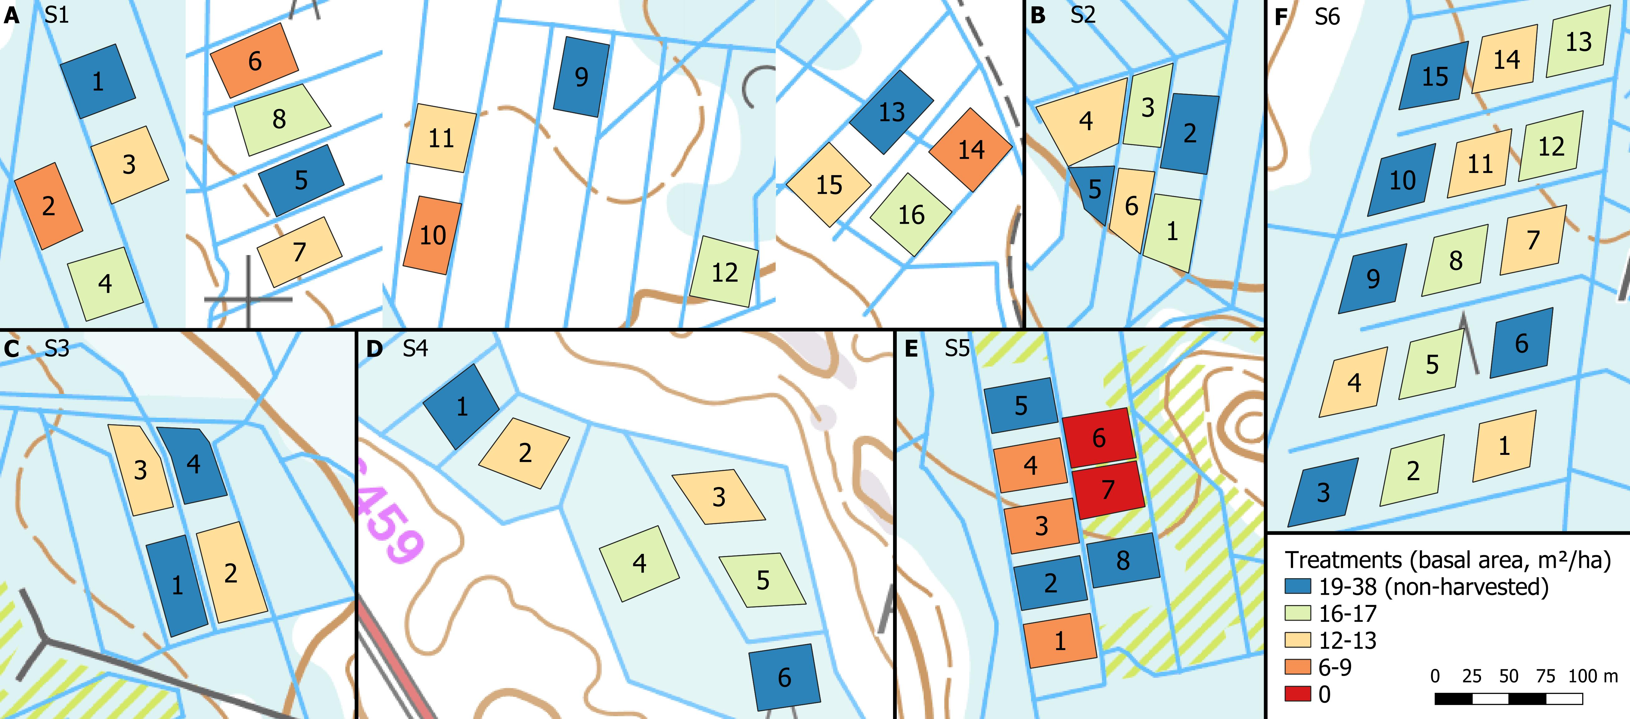
Benchmarking at field sites
6 sites, each with 2 to 4 different BA treatments
First, model set up for each site & treatment:
Peat type, ditch spacing, ditch depth, stand BA
Run by local weather for 2014 – 2019
Target variable: daily WTL, aggregated to June-Oct mean, compated against observed
Leppä, K. et a. 2020. Front. Earth Sci., 8: 576510. https://doi.org/10.3389/feart.2020.576510

Slide 8
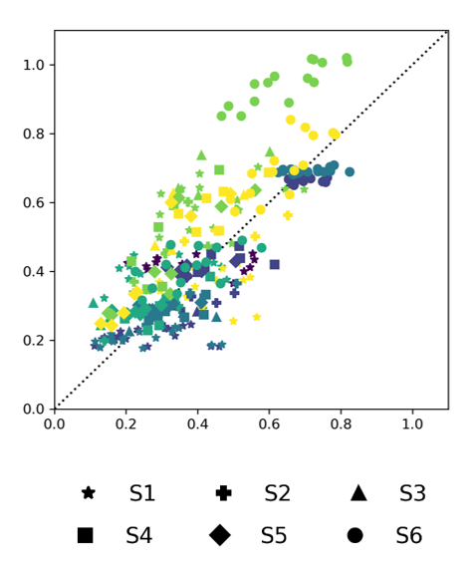
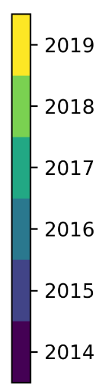
Benchmarking & factorial experiment
June-Oct mean WTL on the right ballpark
Next, factorial simulations:
Basal area (BA): 6 to 30 m²ha⁻¹, 5 levels
deciduous fraction: 0 & 0.5
ditch spacing: 25 & 75 m
ditch depth: 0.3 & 1.0 m
peat type: sphagnum/carex
climate: south/north
Total 180 combinations
WTL[m]
Modelled
Observed
Leppä, K. et a. 2020. Front. Earth Sci., 8: 576510. https://doi.org/10.3389/feart.2020.576510

Slide 9
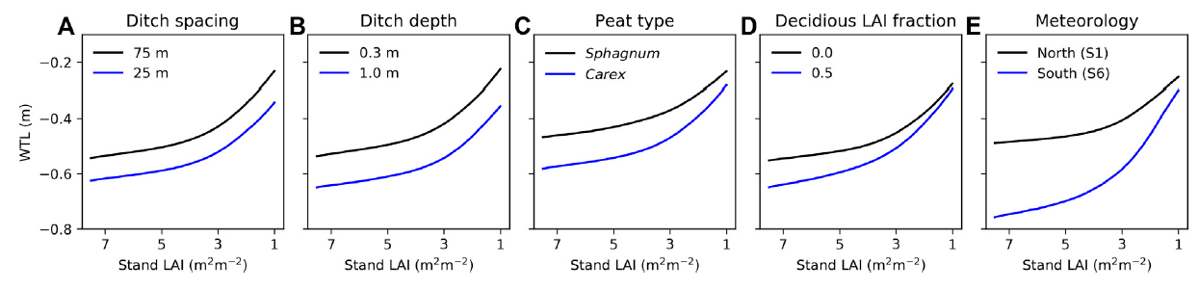
WTL vs. stand leaf-area
Deepens non-linearly with LAI,
increased interception & transpiration.
Mixed stands Understories
Use cases:
Productivity and GHG-balance tradeoff of alternative management (e.g. Eyvindson et al. 2023, https://doi.org/10.1139/cjfr-2022-0101, Lehtonen et al. 2023, preprint)
New guidelines for DNM: shallow ditches are often enough (Hökkä et al. 2022, https://doi.org/10.14214/sf.10494)
BA & Vol

Slide 10
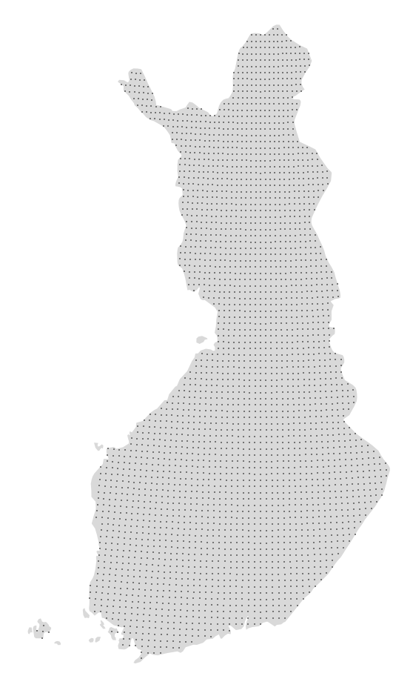
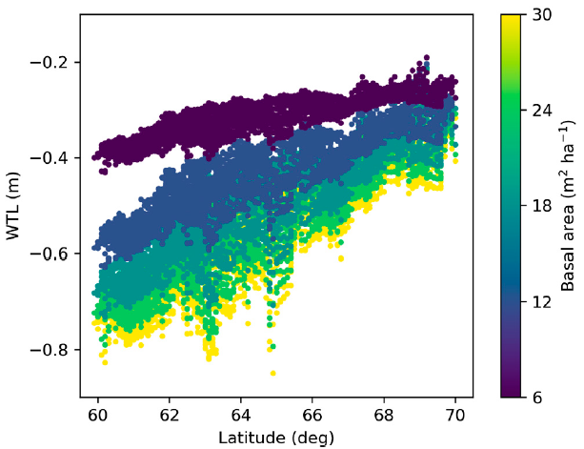
Simulations over climatic gradient in Finland
Biological drainage (ET) has great role in Southern Finland
Strong potential for using CCF, less need for DNM
Ditch drainage remains crucial in Northern Finland
Patterns will shift with climate change, due changing ET/P
Can WTL become too deep in the future?
ET
ET
ET / P

Slide 11
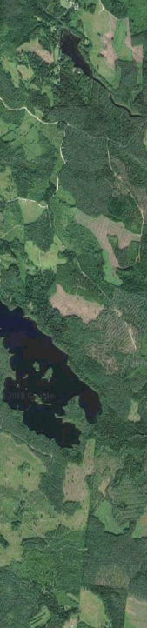
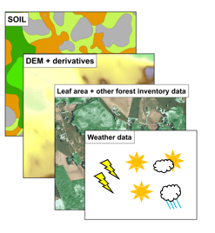
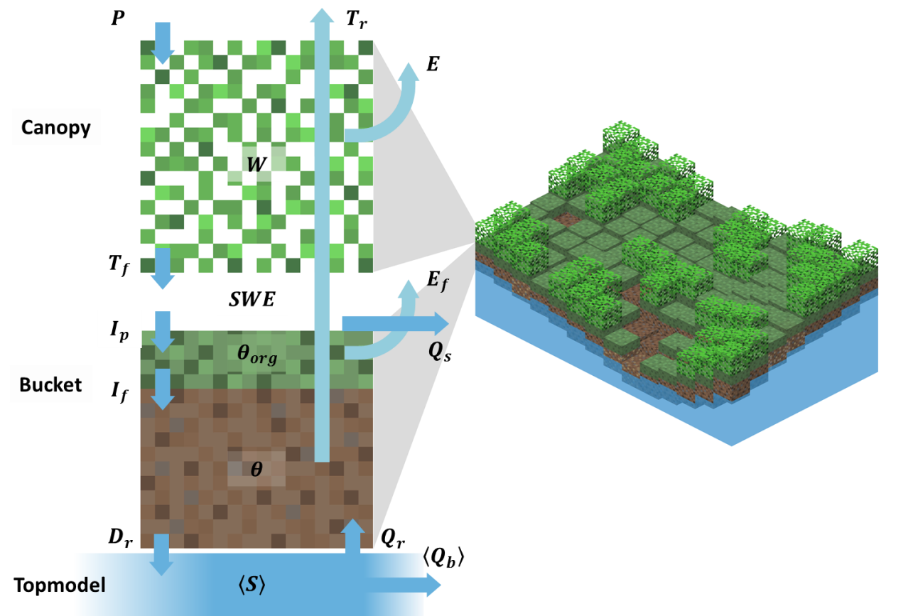
Landscape soil moisture
Soil strength: trafficability, harvest planning
Water availability: climate change adaptation
Excellent open data on
Stand attributes (mNFI,16x16m)
DEM, topographic wetness indices
Streams, water bodies, non-forest areas
Soil hydraulic properties?
We developed new PTF’s to predict soil porosity, field capacity & wilting point from available spatial data
Mineral forest soils: can be best estimated based on soil fertility type available in mNFI
Launiainen et al. 2019; https://doi.org/10.5194/hess-23-3457-2019
Launiainen et al. 2022, https://doi.org/10.3390/f13111797

Slide 12
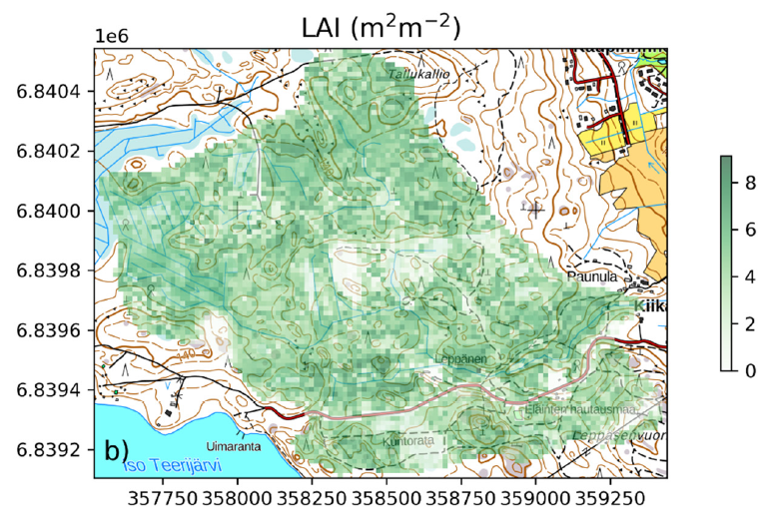
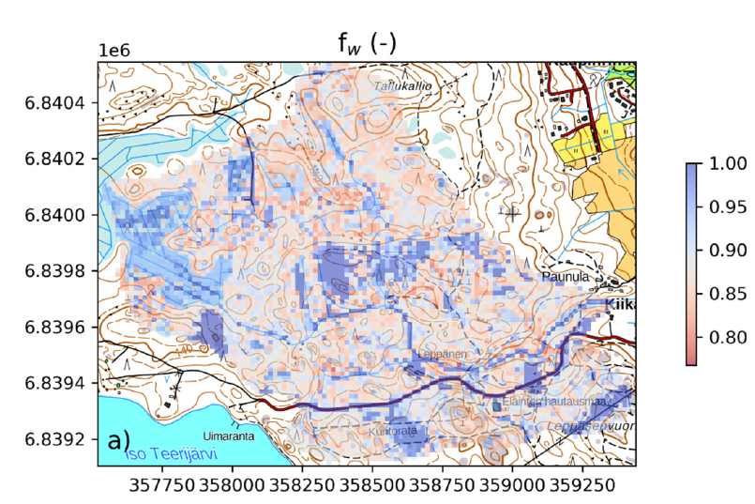
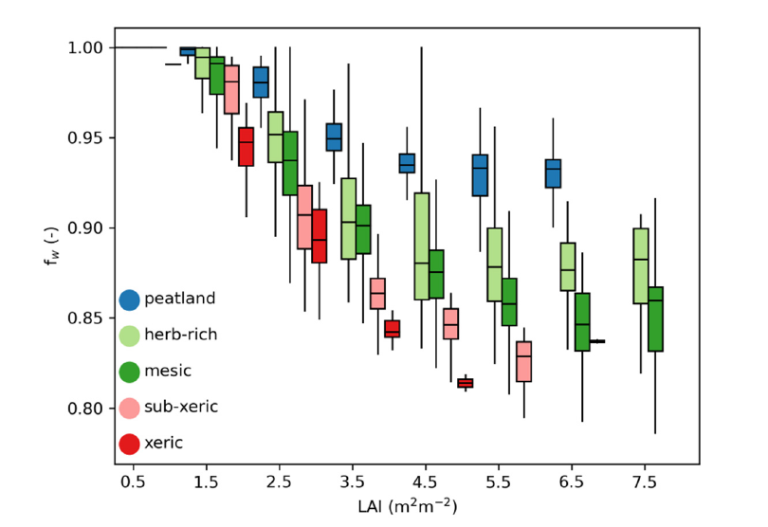
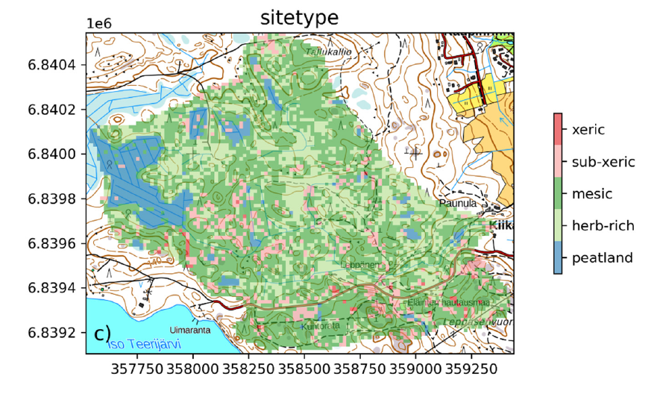
Water limitations – where most likely?
Paunulanpuro –catchment (ca. 150 ha), Orivesi, Southern Finland
Simulated daily soil moisture for 2000 – 2015 period
Increasing
water limitations→
BA & Vol
Stand density effects modulated by soil water
holding capacity, topographic position and species composition
From mNFI
Launiainen et al. 2022, https://doi.org/10.3390/f13111797

Slide 13
Ecosystem ecology with process-based models
pyAPES: vertically resolved view to soil-vegetation-atmosphere interface
→ ¹³C & ¹⁸O isotopes; lidar-based canopy structures
SpaFHy: distributed ecohydrology
→ high-resolution carbon budgets, merging with EO-data
NutSpaFHy: distributed nutrient balance & leaching
→ Stand growth, fertilization effects
Peatland Simulator Susi: holistic peatland forest management
Collaborating with Annamari Laurén (UH, peatland forestry)
Modular, open Python code
From forest structure to hydrological function – merging dense Earth Observation data and process-models (LS-HYDRO, 2023-2027)
Precision nutrient management - a tool for mitigation of climate change and environmental loading in boreal forestry (PREFER, 2022-2026)
See: https://github.com/LukeEcomod

Slide 14
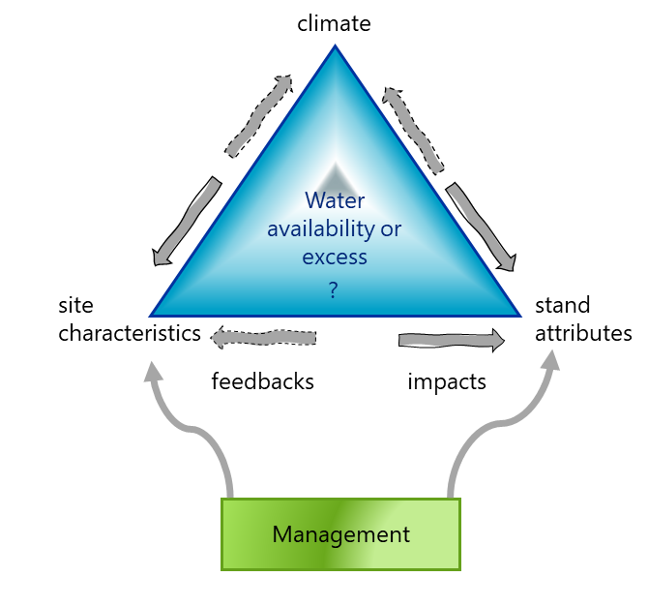
What next?
Climate-change adaptation: need to integrate ecohydrology better into forest dynamics models
How water availability affects growth & mortality?
How and where adapt management?
Capability to predict soil moisture and water table dynamics opens new possibilities for
Understanding & predicting forest disturbances
Fire risks
Forest vehicle trafficability
Future collaboration?

Slide 15

Thanks & let’s keep in touch!
From forest structure to hydrological function – merging dense Earth Observation data and process-models (LS-HYDRO, 2023-2027)
Precision nutrient management - a tool for mitigation of climate change and environmental loading in boreal forestry (PREFER, 2022-2026)
A novel intra-molecular isotopic approach to infer past climate and plant responses from tree-ring archives (MoleO, 2021-2025, Katja Rinne-Garmston)
Tracking isotopic signals in trees using mechanistic modeling – unraveling the climatic response of boreal forests imprinted in decadal tree ring archives (2020-2025, Kersti Leppä)
Economic and environmental feasibility of continuous cover forestry on drained organic soils (CCF-Peat, 2017-2021, Mika Nieminen)
Novel soil management practices – key for sustainable bioeconomy and climate change mitigation (SOMPA)
Greenhouse Gas Fluxes and Earth System
Feedbacks (GreenFeedBack, 2022-2026)
Contact: samuli.launiainen@luke.fi
See: https://github.com/LukeEcomod

Slide 16



You can find us online
luke.fi
Subscribe to our newsletter to stay informed!
luke.fi/newsletter
Natural Resources Institute Finland (Luke)
Latokartanonkaari 9, FI-00790 Helsinki

